Slide 1



CAIRO WEATHER ANALYSIS (2009-2024)
Temperature Trends & Statistical Analysis
Presented by:
Farida Osama - 24-101513 Hana Ahmed - 24-101108
Tasnem Ahmed - 24-101166 Abdelrahman Ahmed - 24-101501

Slide 2




RESEARCH QUESTION
Has Cairo’s temperature increased significantly over time?

Slide 3

HYPOTHESIS
H0 (Null Hypothesis): No significant trend in temperature in Cairo.
H1 (Alternative Hypothesis): There is a significant trend in temperature in Cairo.

Slide 4

DATA OVERVIEW
Time: Feb 1, 2009 - Dec 31,2024
5,813 observations
Source: Open-Meteo (Kaggle)
Focus: Temperature

Slide 5
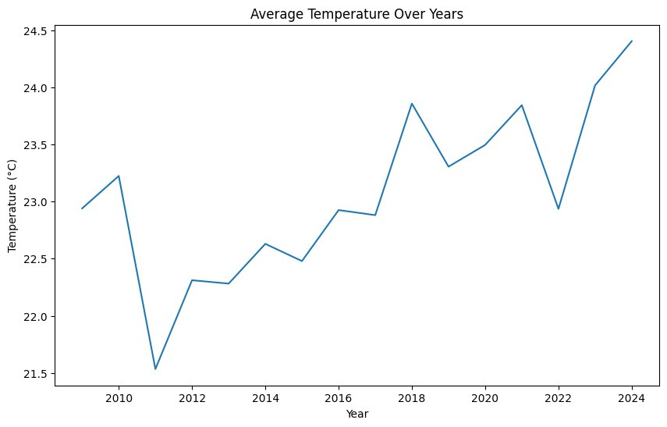

LINE PLOT
Temperature Increasing Over Time
General Upward trend after 2015
Noticeable rise in recent years
peak around 2024

Slide 6
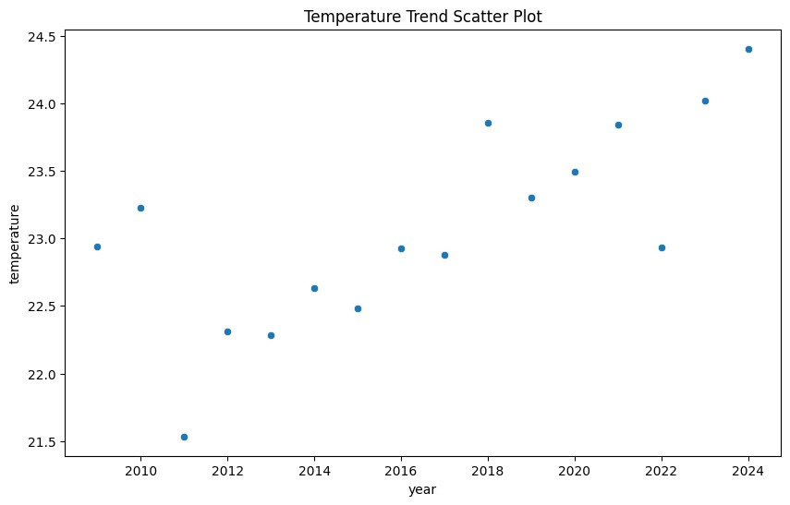

SCATTER PLOT
Years vs Temperature Distribution
Data points show gradual increase
Later years cluster at higher values

Slide 7
KEY INSIGHTS
Temperature increased from ~22.2°C → ~23.9°C
Total increase ≈ +1.7°C
Clear evidence of warming trend

Slide 8
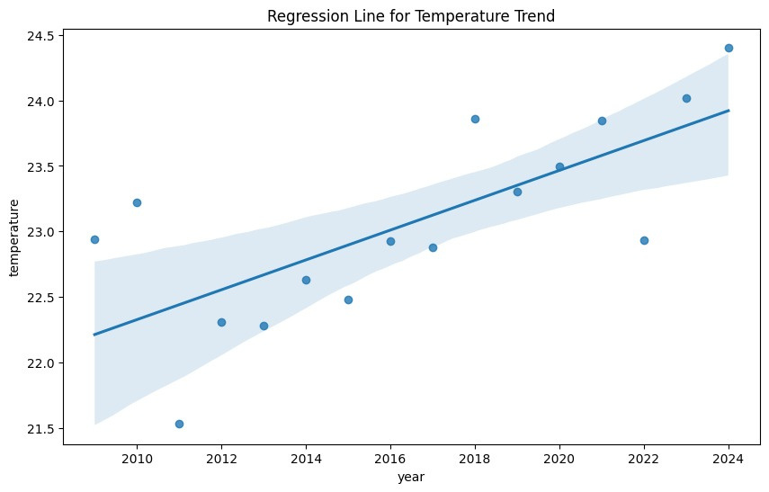

REGRESSION ANALYSIS
Positive Trend Confirmed
Regression line shows positive slope
Temperature rises consistently over time

Slide 9
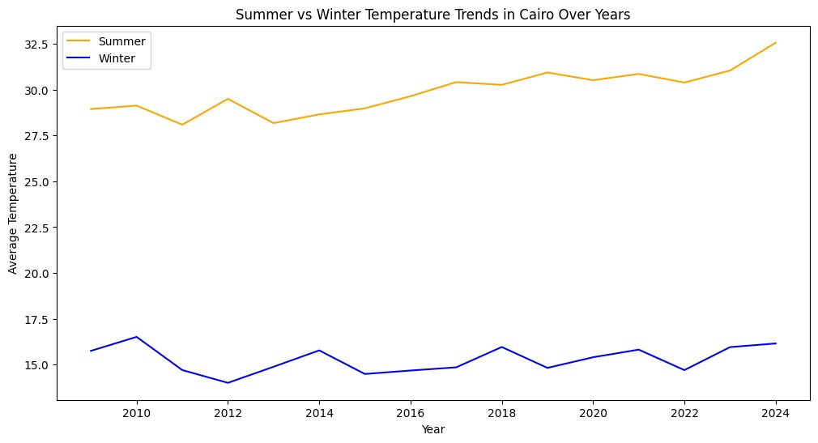
SEASONAL ANALYSIS
Summer vs Winter
Summer temperatures increase significantly
Winter remains relatively stable
Warming mainly driven by summer

Slide 10


HYPOTHESIS TESTING
Method: Linear regression
Significance level α = 0.05
Obtained p-value < 0.05
∴Decision: Reject H0

Slide 11
CONCLUSION
Cairo’s average temperature is increasing over time.
The trend is statistically significant based on linear regression.
Recent years show higher temperature values than earlier years.

